Slide 1
VA Fusion
Arjun Comar
Mary Roth

Slide 2
Features
Piano Mode
– Snap-to Recording
– Forced Rhythm
– Free Recording
– Instrument Selection and Combination
– Free Play
Staff Mode
– Simple gestures, character recognition
– Quick Adjustments
– Overall view
– Play snippets or the whole piece
– Copy/Paste!

Slide 3
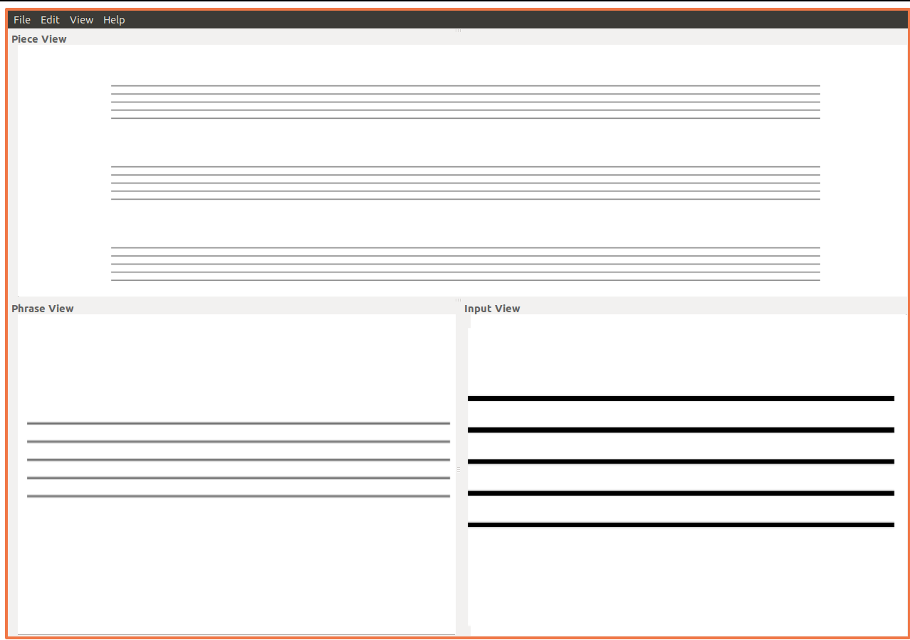
Staff Mode Mockup

